Slide 1
Preliminary Design Review
01/31/2023

Slide 2
READ THIS FIRST
Things to address in your slides​
Why did you decide on this approach?​
What thought process led you there?​
What other approaches did you consider?​
Why did you decide on one approach over another?

Slide 3
Overview
Concept of Operations
Software Design
Software Subsystems
Work Breakdown Structure & Gantt Chart

Slide 4
Concept of Operations

Slide 5
Concept Of Operations (High Level)
Reported fire and missing person in respective search locations
Deploy UAS
Follow set of waypoints to search location
Static obstacles are present
Other UAS are present
Locate fire
Navigate the other search area
Locate missing person and report location to ground
Notes:
Throw to Danny
What tasks are our priority? Rank of what we want to attempt – will work on these in order and anything not time for will cut from bottom. Is there a specific score or rank we want to achieve?

Slide 6
1. Reported Fire / Missing Person
Receive reports from ground control involving fire or missing persons
Generalized location and environment defined beforehand
Search area locations currently scheduled to reside in an open field sectioned into four separate areas
Search Area 1, Search Area 2, Avoidance Area, and Takeoff Zone
AMA field, Springfield Beckley Municipal Airport, or other area defined by advisors
Detection of a fire that is at least 2 feet across in the search area
Detection of a person moving at a minimum of 1.3 meters per second
Pre-mission brief to include
Summary of planned tasks
Identification of Team Lead/Safety Pilot
Teams have 40 minutes to complete the mission

Slide 7
2. Deploy UAS
Departure of UAS to search locations
UAS must be able to fly 8 miles when fully loaded in a single flight
UAS must weigh 55 pounds or less at takeoff
Unless operating under a COA
Teams are limited to 30 minutes of flight time
Which is when the team occupies the runway or airspace
The UAS must autonomously RTH/RTL after 30 sec of comm. loss
UAS must be capable of resuming a mission after an interruption

Slide 8
3. Follow Waypoints to First Search
Obstacles are bounded polygons that must be avoided
Waypoints are sets of (Latitude, Longitude, Altitude) points
Distance between first and last waypoints may be up to 6 miles in length
Planned path for the mission must be able to fly autonomously
Waypoints, flight boundary, etc. received from interop server
Max waypoint error is 25 ft absolute distance from waypoint location
Must fly through waypoint path after every takeoff
UAV must remain in communication range up to distance of 1 mile

Slide 9
4. Locating Fire
Finding reported fire located in first search area
UAS must detect fire that is at least 2 ft across in the search area
Images of the entire search area must be captured within 5 minutes
Overall image processing must be at least 0.4 frames per second
Fire Identification boundary must be displayed
UAS must localize detected fire in GPS coordinates
Localization is done in real time
GPS localization is within 5 feet on average
Interop must grade the accuracy of the fire localization

Slide 10
Fire Suppression Drop
Airdrop release to extinguish located fire
UAV must release a payload that can extinguish a fire
Payload must be dropped with max distance error of 1 ft from target
Payload must weigh less than 5 pounds
Payload must be no larger than 12in x 12in x 6in
Drop mechanism used to release payload
Must be easy to service
Interop must grade if the fire is extinguished

Slide 11
5. Navigation to Second Search
Travel from suppressed fire location to lost hiker search location
Obstacle Avoidance while traveling
UAV must be able to avoid simulated static obstacles
UAV must be able to avoid simulated dynamic obstacles
Boundaries for each avoidable obstacle must be displayed
Telemetry
Must be downloaded for all other vehicles (simulated or real)
Must be processed at an average rate of 1 Hz
Interop server tracks violations of static obstacle boundary and min distance of other aircraft, then deduct points accordingly

Slide 12
6. Locating Missing Person
Finding lost hiker in second search area
Detection of a person moving at a minimum of 1.3 meters per second
Images of the entire search area must be captured within 5 minutes
Overall image processing must be at least 0.4 frames per second
UAS must localize detected hiker in GPS coordinates
GPS localization is within 5 feet on average
Interop must grade the accuracy of the hiker's localization

Slide 13
Software Design

Slide 14
Overall Architecture
Highly Modular
Use ROS 2 as basic framework (pub/sub architecture)
Abstract algorithms into classes
Wrap algorithm classes into nodes
Easily deployable
Use Docker to easily configure environment

Slide 15
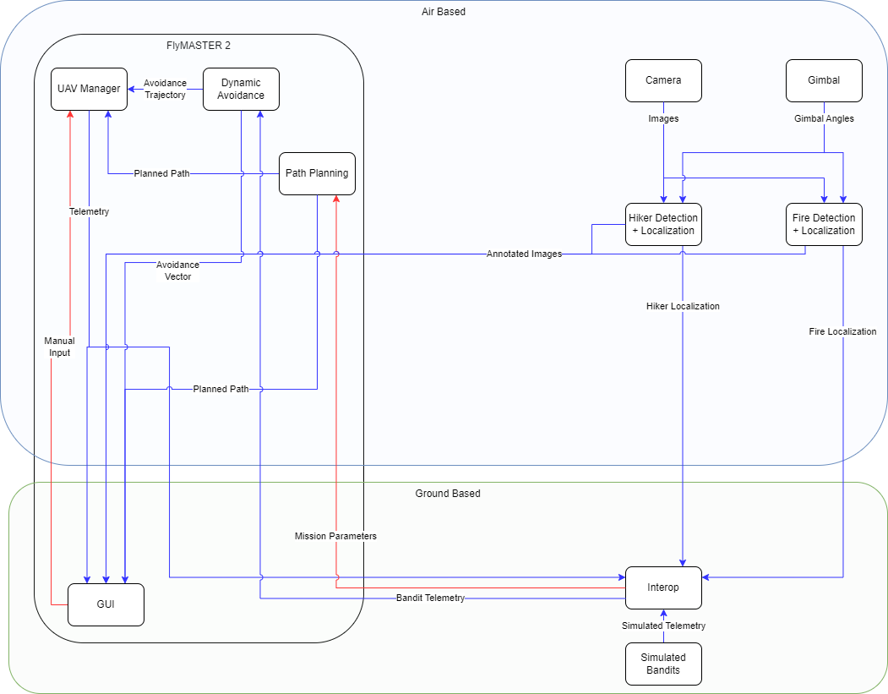
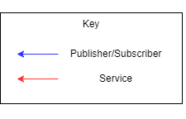

Slide 16
Interop Server

Slide 17
Interop Server Responsibilities
Publish mission parameters
Mission boundaries
Waypoints
Obstacles
Receive and publish telemetry from simulated bandits
Receive and grade telemetry data from team
Waypoint accuracy
Static + Dynamic avoidance
Detection of fire and hiker
Total Mission time for completion
Receive and grade localization data from team
Single best result
Averaged results

Slide 18
Interop Server Design Considerations
Communication interfaces
ROS built-ins where possible/sensible, custom message types elsewhere
Simulated Bandits
Use ArduPilot simulation for bandits
Bandits will fly a pre-generated trajectory read from disk
Communicate with server using mavlink
Publishes on single topic and has different IDs for each bandit
Scoring Class with methods to compute score
Waypoint accuracy
Avoidance
Localization

Slide 19
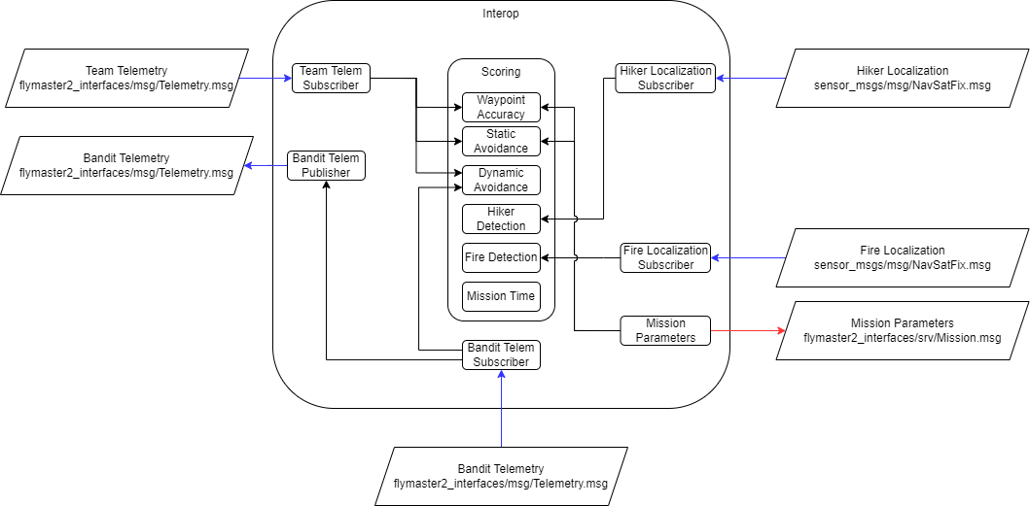
Interop Server Design Considerations

Slide 20
Interop Server Success Criteria
Starts with single command
Connects automatically once started
Remains connected for entirety of required mission time
10 Hz update rate
Correctly grades every section of the mission, including
Waypoints
Avoidance
Detection
Time
Inputs and Outputs are easy to read, understand, and access

Slide 21
FlyMASTER 2

Slide 22
FlyMASTER 2 Responsibilities
Command and control of autopilot (PX4 or ArduCopter)
Display mission elements
Vehicle state
Flight boundaries
Waypoints
Obstacles
Modular task execution
Error reporting and handling
Unable to complete task
Loss of communication
Low battery

Slide 23
FlyMASTER 2 Design Considerations
Levels of abstraction
Vehicle
Autopilot
Interfaces
UX – presentation and organization of information
Task, Interrupt, and Reporter usage​
Error handling control​

Slide 24
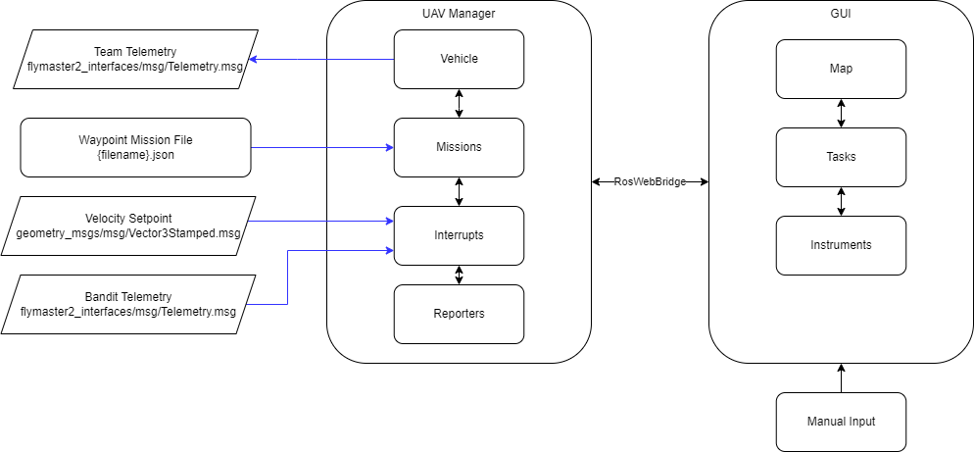
FlyMASTER 2 Design Considerations

Slide 25
FlyMASTER 2 Success Criteria
Controls all flight software functions
Path Planning
Avoidance
Takeoff + Landing
Can manually or programmatically add new missions or tasks
Mission elements displayed and easy to read

Slide 26
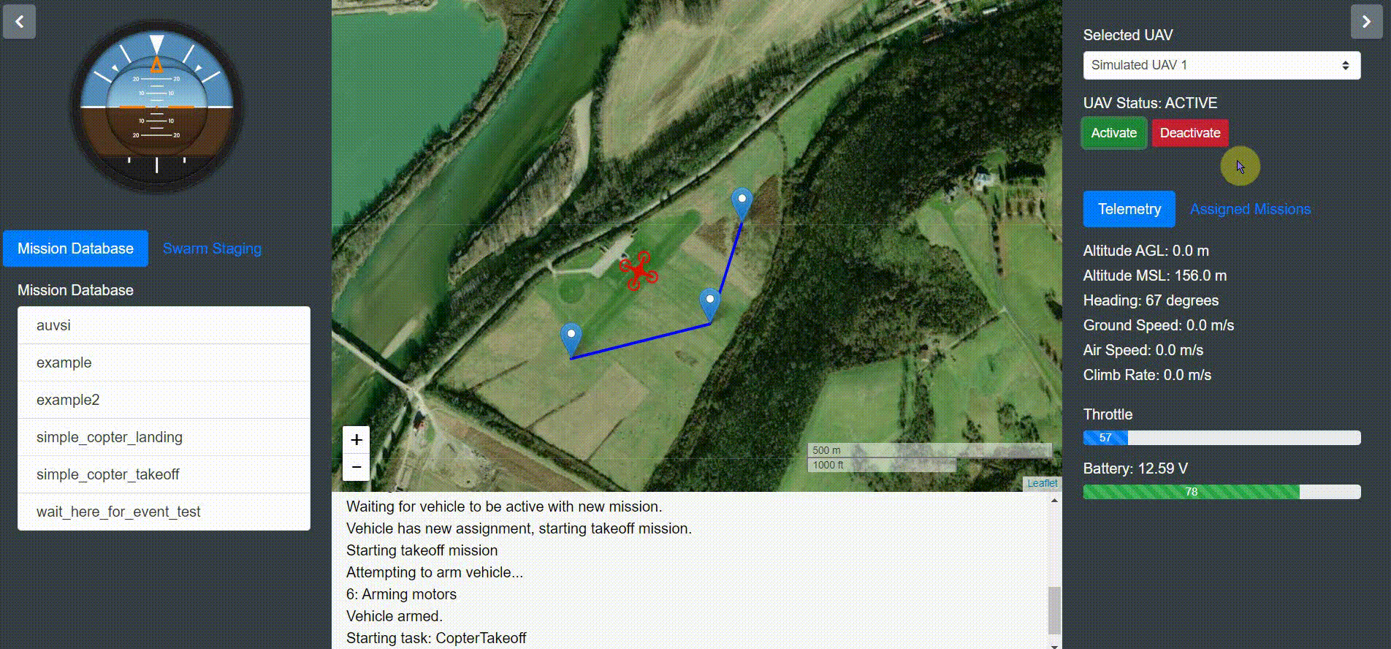

Slide 27
Path Planning

Slide 28
Path Planning Responsibilities
Receive initial input set of waypoints and obstacles from interop server
Produce, then optimize traversal path for waypoints
Output path as ordered list of waypoints

Slide 29
Path Planning Design Considerations
Simple implementations
Arbitrary/Random
Brute Force
Complex implementations
Genetic Algorithm
K-opt heuristic

Slide 30
Simple Algorithms
Brute Force
Check ALL possible orders and select best one
Guarantees the best option is found
VERY resource intensive, likely to take a long time (O(n!))
Useful for validation of other algorithms

Slide 31
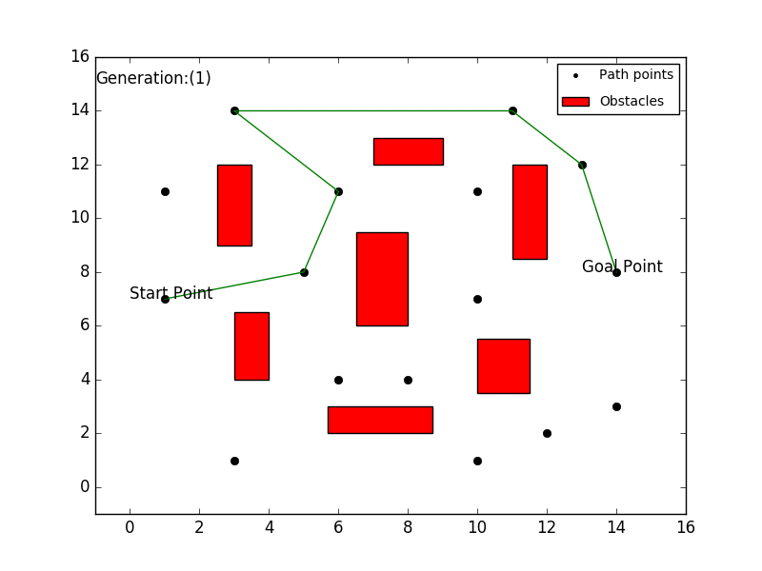
Genetic Algorithm
Slow but Steady
Makes small improvements after each generation based on the specified fitness
Element of randomness can cause major changes
Complexity hard to predict, but requires relatively few comparisons
Expected 150ms per generation
Industry standard for 3D Traveling Salesman Problems
Simple to improve by just swapping in alternate pieces
Cost / Fitness Function
Configured Run Time
Inheritance
Mutations
Likely requires multithreading

Slide 32
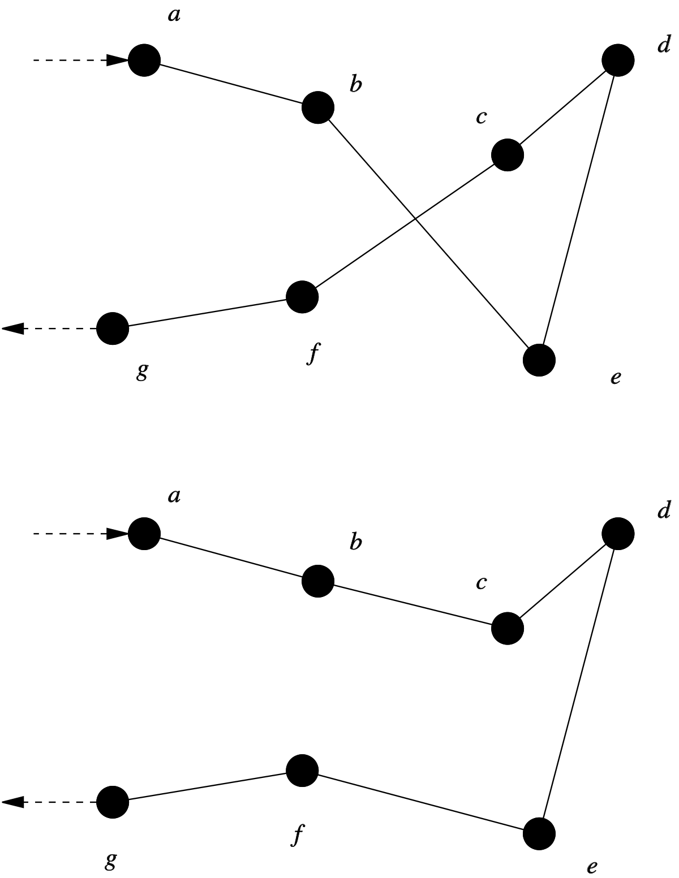
K-opt Heuristic
Essentially optimized brute force
Check all possible connections rather than all orders
Makes improvements one connection at a time
Can be run in a single thread
Designed for 2D environments, minimal study available of effectiveness in 3D

Slide 33
Path Planning Success Criteria
Planned path is generated in less than 1 minute
Planned path is repeatable
Planned path is within 10% of optimal path
Compare with brute-forced solution on small scale
Path can be re-planned during flight if we deviate

Slide 34
Decision Matrix Terminology
Run Time – How long with the algorithm take?
Higher rating means faster run time
Development Time – How long will it take to write the algorithm?
Higher rating means shorter development time
Scalability – How much work needs to be redone if there is a change to the waypoints?
Higher rating means more scalable
Optimality – How close to optimal will the result be?
Higher rating means closer to optimal solution

Slide 35
Path Planning Decision Matrix
Implementation | Run Time (5) | Development Time (2) | Scalability (3) | Optimality (3) | Total
Brute Force | 1 | 5 | 1 | 5 | 33
Genetic Algorithm | 3 | 5 | 4 | 4 | 49
K-Opt Heuristic | 5 | 3 | 3 | 3 | 49

Slide 36
Dynamic Avoidance

Slide 37
Dynamic Avoidance Responsibilities
Receive telemetry input from vehicle and interop server
Detect if vehicle courses are threatening a collision
Generate avoidance trajectory and send to UAV Manager

Slide 38
Dynamic Avoidance Design Considerations
Velocity vs Position Control
Most methods use velocity control in their calculations
Position control is safer because the autopilot handles transitions
Position control would require extrapolation of the velocities
Methods Considered
Gyroscopic forces
Force field
Fuzzy logic

Slide 39
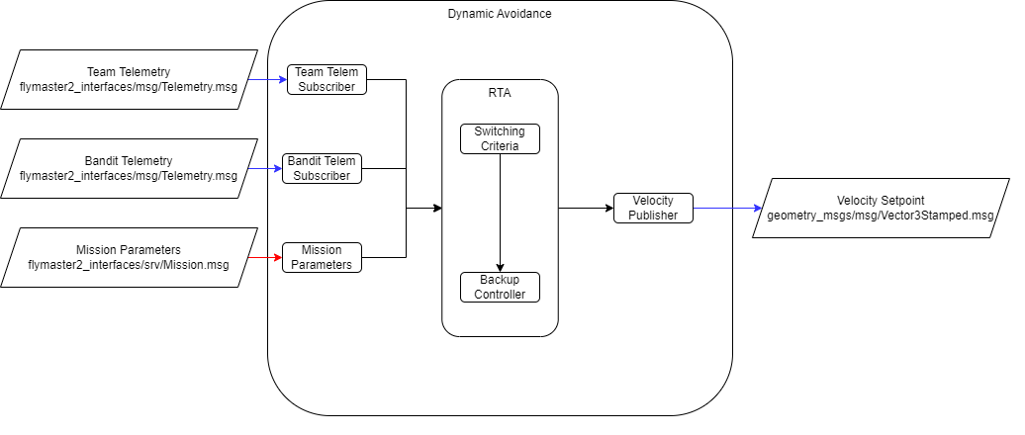
Dynamic Avoidance Design Considerations

Slide 40
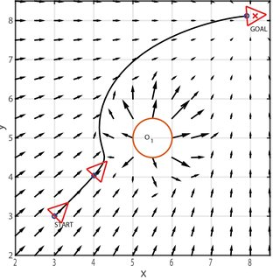
Force Field
Minimizes a cost function for "optimal" behavior
Typically includes inverse of distance to obstacle, distance to target waypoint, and change in velocity
Gains for each of these are determined from testing
Can easily be expanded to 3D and multiple obstacle scenarios

Slide 41
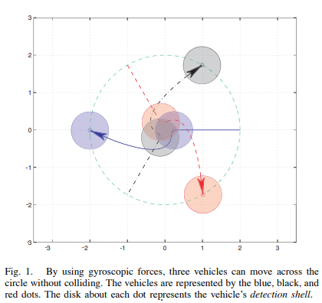
Gyroscopic Forces
Similar to force field's cost function
Based on distance to obstacle, rotation about obstacle, and damping forces
Also easily be expanded to 3D and many obstacle scenarios

Slide 42
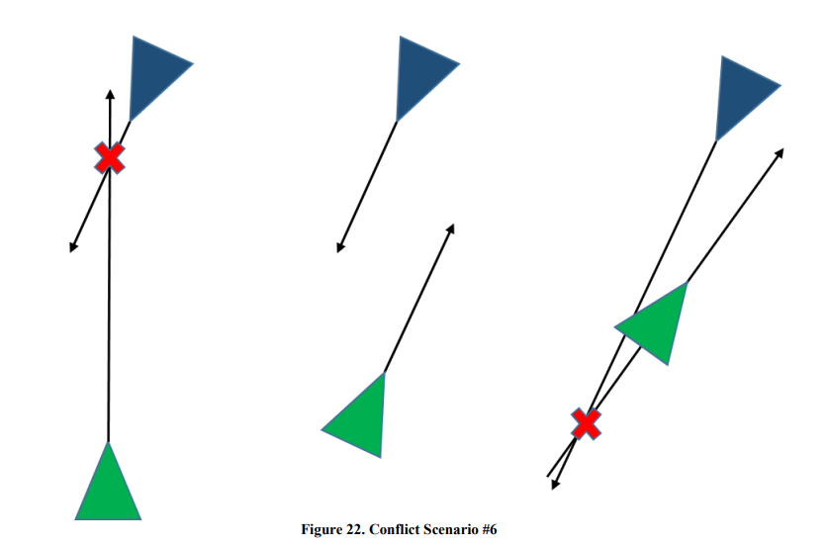
Fuzzy Logic
Typically uses headings and distances to obstacles as inputs
Fuzzy rules based on where the collision would take place
The vehicle can decide to "go behind" or "go ahead" based on this
This is mainly applicable to fixed wings
Rules and performance heavily based on degree of cooperation

Slide 43
Dynamic Avoidance Success Criteria
Prevent all collisions or in air conflicts
Dynamic avoidance must also avoid static obstacles
Commanded velocity does not violate vehicle capability
Max velocity is implemented
Max acceleration should be considered
A distance of min(15, 15*velocity) meters is maintained between vehicles graded by Interop

Slide 44
Decision Matrix Terminology
Run Time – How long with the algorithm take?
Higher rating means faster run time
Development Time – How long will it take to write the algorithm?
Higher rating means shorter development time
3D Scalability – How much work needs to be redone if we expand to 3D obstacles and waypoints?
Higher rating means more scalable
Optimality – How close to optimal will the result be?
Higher rating means closer to optimal solution

Slide 45
Dynamic Avoidance Decision Matrix
Implementation | Run Time (2) | Development Time (2) | 3D Scalability (2) | Optimality (4) | Total
Force Field | 5 (2.6 ms/step) | 4 | 4 | 3 | 38
Gyroscopic | 4 (2.8 ms/step) | 3 | 4 | 5 | 42
Fuzzy Logic | 2 | 1 | 1 | 5 | 28

Slide 46
Detection & Localization

Slide 47
Hiker + Fire Detection Responsibilities
Input images potentially containing objects of interest
Determine if image contains hiker/fire
Transform pixel location of detected object into GPS coordinates
Send annotated image to GCS GUI to display
Submit to interop

Slide 48
Hiker + Fire Detection Design Considerations
Implementations considered
Classic/thermal/combination imagery
Yolo v7
Extended Kalman Filter
DeepSort

Slide 49
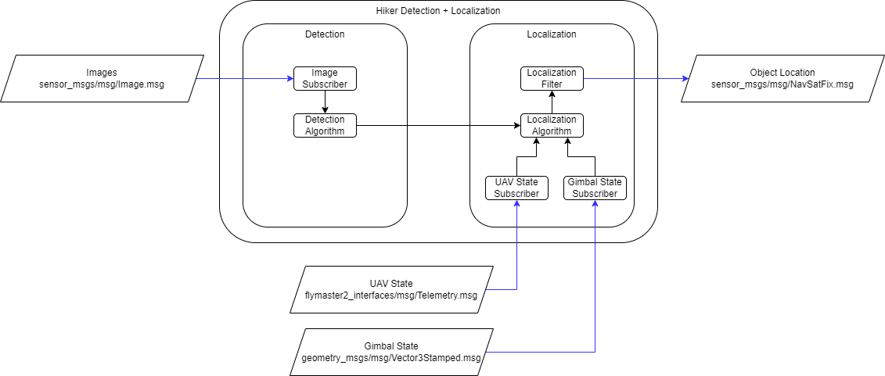
Hiker + Fire Detection Design Considerations

Slide 50
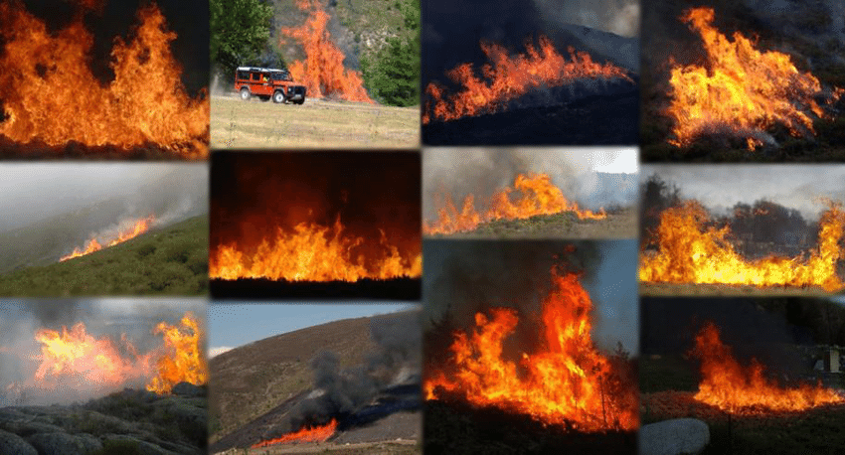
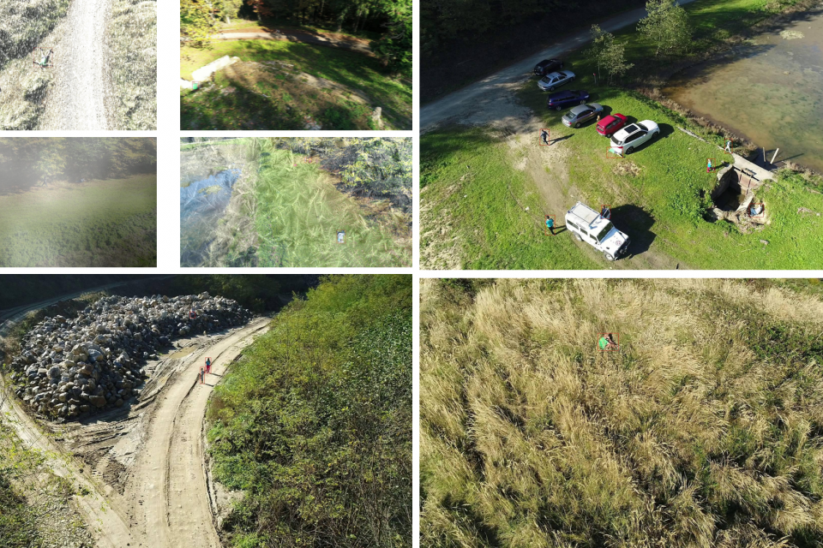
Classical Imagery
No specialty camera required
Large classical image datasets are available
Better for training YOLO
Datasets available for both fire and hiker detection
Visible color error is possible
Ex. A pile of red leaves is mistaken for fire
May require much more intensive training to avoid the error

Slide 51
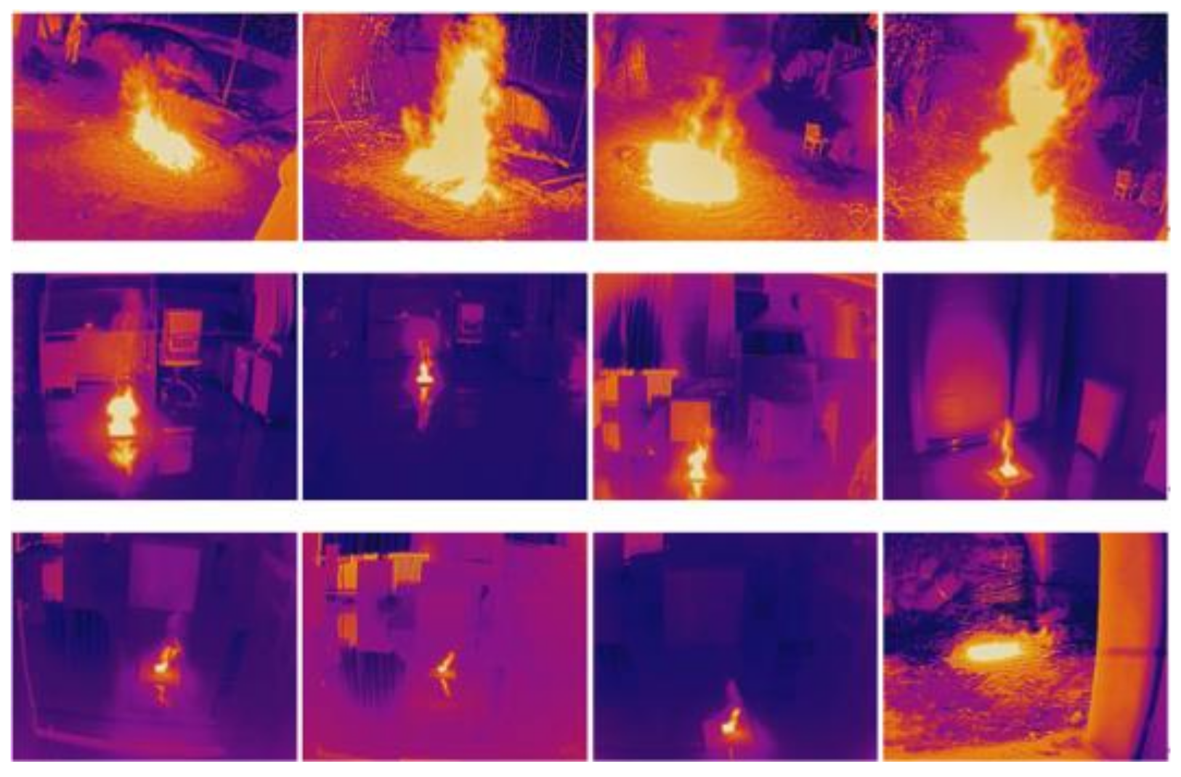
Thermal Imagery
Avoids visible light errors
Both fire and hiker are high temperature sources
Can ignore conditions like fog, cover, etc.
Lack of readily available datasets
Detection algorithm must recognize relative trends rather than absolute
Hiker and fire are highly different temperatures, but both are relatively warmer than their environments
May also recognize other living objects/heat sources
Combining thermal with classical may allow thermal imagery to support the accuracy of the classical imagery

Slide 52
YOLO v7
Detects objects both quickly and accurately
Ideal for real-time processing when compared to other detection algorithms
Well documented previous versions that apply to v7 as well
Easy to train effectively
Documentation on training YOLO for search and rescue readily available
Bounding boxes can fluctuate, especially in flight
Localization from high altitudes can be difficult
Noise can alter the pixel location of an object
Need something to reduce noise for accurate geolocation

Slide 53
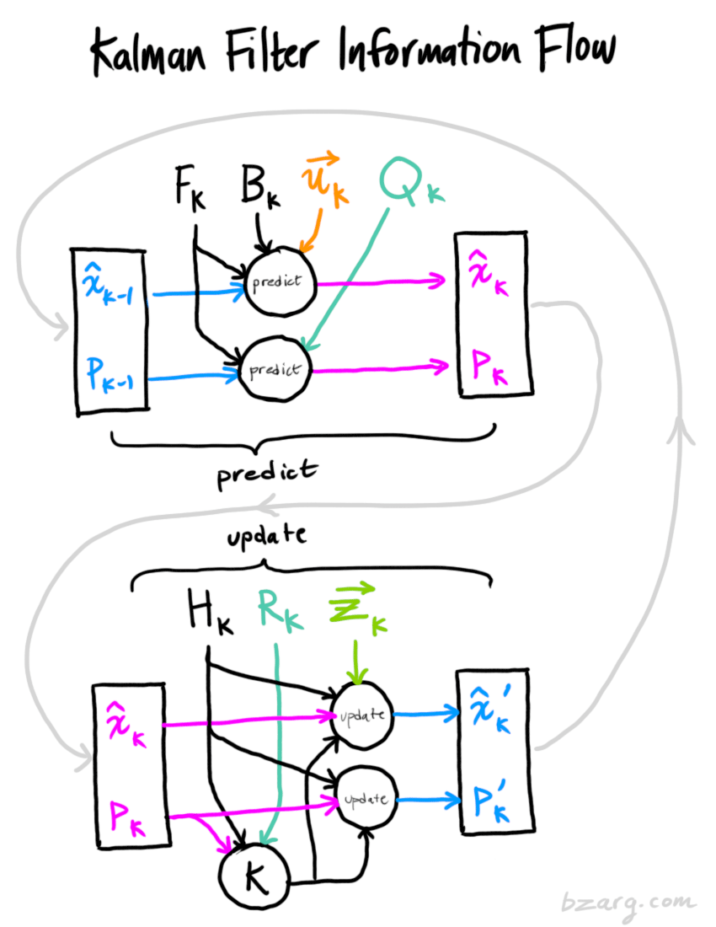
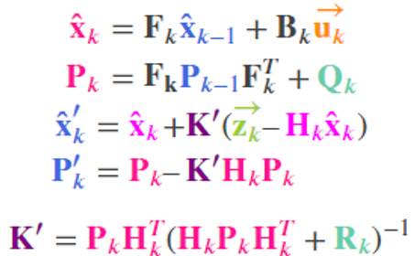
Extended Kalman Filter
Filter to reduce noise and increase geolocation accuracy
Predicts movement of target, improves over multiple detection frames
Commonly used filter with readily accessible equations and operations
Effective for both stationary and moving targets
Ready-to-use ROS 2 EKF
https://docs.ros.org/en/noetic/api/robot_localization/html/state_estimation_nodes.html

Slide 54
Hiker + Fire Detection Success Criteria
Hiker/Fire are detected in 95% of images they are present in
GPS localization is within 5 feet on average
Localization maintains accuracy regardless of location/environment

Slide 55
Decision Matrix Terminology
Data Availability – How much training data is available to use?
Higher rating means more/larger datasets accessible
Hardware Required – How complicated/available is the hardware required?
Higher rating means more accessible/simpler to work with
Training Intensity – How much training will it take for the object detection to have a true positive of over 95%?
Higher rating means less time/generations likely required to train YOLO
Error Proneness – How likely is an object detection error to occur?
Higher rating means higher accuracy rating

Slide 56
Imagery Decision Matrix
Implementation | Data Availability (4) | Hardware Required (3) | Training Intensity (2) | Error Proneness (5) | Total
Classical | 4 | 4 | 2 | 3 | 47
Thermal | 1 | 3 | 3 | 3 | 34
Combined | 1 | 2 | 1 | 5 | 37

Slide 57
Work Breakdown Structure & Gantt Chart

Slide 58
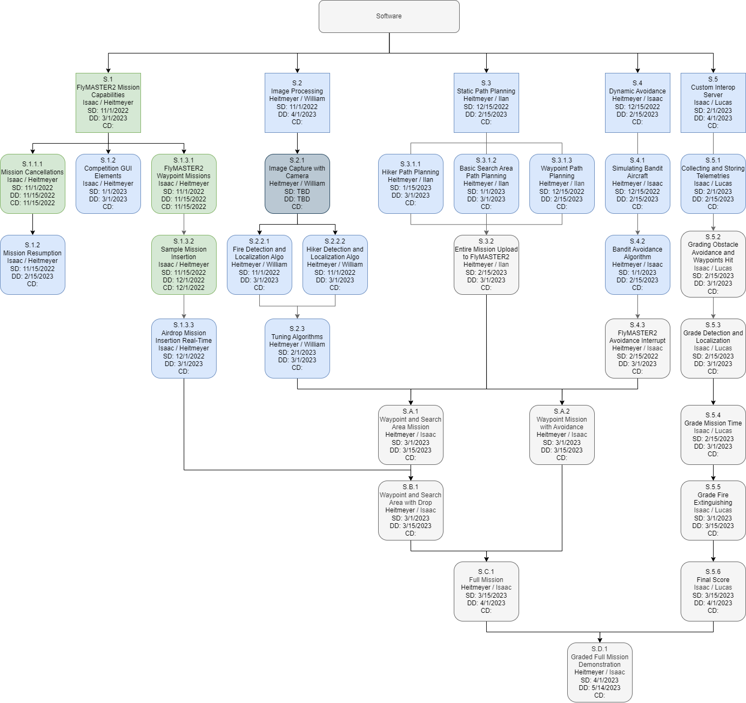
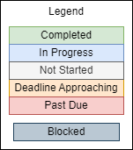
Software: High Level

Slide 59
Software: In-depth

Slide 60
Software: In-depth

Slide 61
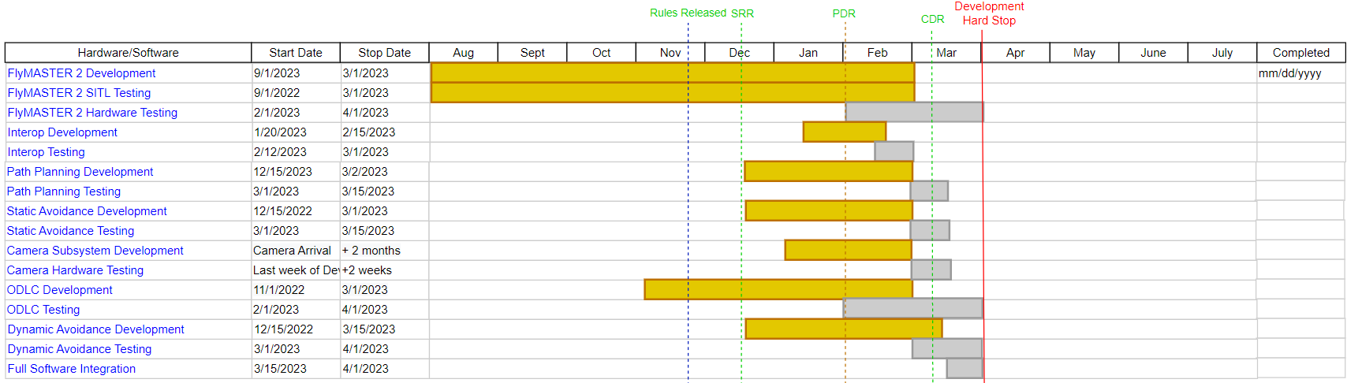
Deliverables

Slide 62
Thank you! Questions?

Slide 63
Appendix

Slide 64
Avoidance Links
Fuzzy/Heading Based
https://arc.aiaa.org/doi/pdf/10.2514/6.2015-2031 Brandin Cooks
https://www.researchgate.net/publication/264742784_A_Novel_System_for_Non-Cooperative_UAV_Sense-and-Avoid
Gyroscope
http://www.cds.caltech.edu/~marsden/bib/2003/15-ChShMaOl2003/ChShMaOl2003.pdf
Force Field
https://link.springer.com/content/pdf/10.1007/978-3-319-17765-6.pdf?pdf=button
https://ieeexplore.ieee.org/stamp/stamp.jsp?tp=&arnumber=664154

Slide 65
Avoidance Lit Review
A review on collision avoidance systems for unmanned aerial vehicles. 3 major approaches – Rule based which uses pre-defined rules (ex. turn left always) NOT good for unexpected maneuvers in our case. This would work for commercial flights but not here.
Force field approach - Can require fast changes in speed or direction. Not guaranteed solutions because vehicle cant handle some of the maneuvers.
http://www.cds.caltech.edu/~marsden/bib/2003/15-ChShMaOl2003/ChShMaOl2003.pdf There exists a neighborhood that can trap the vehicle. Computationally could be tough and only considers single vehicle typically. So use gryoscopic forces. Completely decentralized.
3 forces. Potential force with minimum at the target. Damping force. Gyroscopic force. Potential is gradient of field to the target. Damping is simply velocity driven. So is gryo force. This seems like a direct upgrade to jared stuff. Works in 3d and 2d. Lets go with 2d. Floor and ceiling are interesting
Optimized approaches – cost function like flight time, energy, deviation, etc. Includes game theory, genetic based, optimal control methods. Non cooperative game in our case
Conflict Resolution for Multi-Agent Hybrid Systems. describes this cost function use in zero sum game theory. Notably for fixed wings but the cost function and velocity approach matches jared code
Optimized can be computationally hard and unexplainable... time to mention fuzzy
A Novel System for Non-Cooperative UAV Sense-And-Avoid – just math here for desired heading vs current and obstacles. They did include EKF and some trajectory predictions which could be useful in addition to our stuff.
Fuzzy stuff – think brandin cook things here. Headings and distances. Super boring and not optimal. Its explainable whoop di doo
3dTSP genetic algorithm analysis - https://www.hindawi.com/journals/jat/2022/4124950/

Slide 66
Detection Literature Review
https://ieeexplore.ieee.org/document/9369386 - Search and Rescue using YOLO on UAV
Gives specific YOLO training parameters, demonstrates high success rate using YOLO
https://ieeexplore.ieee.org/abstract/document/9345010?casa_token=fePDbnnjgFUAAAAA:DVoQw1i3yC8bAwd4H6Hq78jsfTyXmOZ6Qn-MIUwqq9DIt1H3Ln9HeRDIZIqh2gM106rLa3k - Using YOLO and DeepSort to detect objects
Demonstrates DeepSort, a program for detection and localization refinement, which is built off of a Kalman filter
DeepSort has many advanced detection capabilities, however most of these are beyond the scope of the mission at hand
https://www.bzarg.com/p/how-a-kalman-filter-works-in-pictures/
How a Kalman filter works in pictures

Slide 67
Path Planning Literature
https://ieeexplore.ieee.org/abstract/document/9080397

